Slide 1

Mini Project review on
CHESS WITH AI
Harshit Mhatre TU8F2122024 (A34)
Chaitanya Deokar TU8F2122037 (A47)
Utkarsh Tiwari TU8F2122025 (A35)
Manas Thosar TU8F2122028 (A38)
BATCH A2 SE GROUP NO.5
UNDER THE GUIDANCE OF
Prof. Sayalee J. Narkhede
------------------------------------------------------------------------------------------
DEPT. OF ARTIFICIAL INTELLIGENCE AND DATA SCIENCE
TERNA ENGINEERING COLLEGE, NERUL.

Slide 2
TABLE OF CONTENTS
Introduction
Problem statement
Applications of chess
Literature survey
Algorithm
Design and implementation
Result images
Conclusion
Future work
References

Slide 3

INTRODUCTION
Chess is one of the oldest and most popular board games. It is played by two opponents on a checkered board with specially designed pieces of contrasting colors, commonly white and black. The objective of the game is to capture the opponent's king.

Slide 4
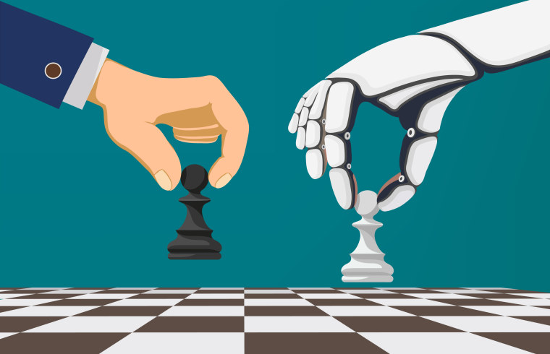
CHESS AGAINST COMPUTER (AI)
Computer chess includes both hardware (dedicated computers) and software capable of playing chess. Computer chess provides opportunities for players to practice even in the absence of human opponents, and also provides opportunities for analysis, entertainment and training.
Fig.1: Human VS AI

Slide 5
PROBLEM STATEMENT
Developing a chess AI which can play the game of chess at a high level. This requires a combination of various techniques including game tree search, decision making, and algorithms, to allow the program to make intelligent moves and adapt to different playing styles. The ultimate goal is to create an AI that can beat human opponents and compete with the best chess programs in the world.

Slide 6
REAL LIFE APPLICATIONS OF CHESS
Critical thinking (Are some moves better than others?)
Analytical skills (What's my opponent likely to do?)
Spatial awareness (Where can a given piece move?)
Patience (Good strategies take time to develop)
Courtesy (Be a good loser and winner, no table flips)

Slide 7
LITERATURE SURVEY
Sr. No. | Paper Details Authors, “Title”, Resource Name, Year, page nos. | Problem Addressed | Methodology Used | Advantages/ Strengths Found | Disadvantages/ Limitations/Gaps Found
1 | Robert Levinson, Feng-hsiung hsu, T. Anthony Marsland, Jonathan Schaeffer and David E. Wilkins, January 1991, “Role of chess in artificial intelligence research”, Proceeding of the 12th International Joint Conference on Artificial Intelligence, 547-542. | Expert Inputs are Sometimes Harmful Open Problem and Lessons for AI. | Given a patient and seemingly perfect teacher (chess-playing machine), how should one use it to "teach" an Al-based learning program about strategies for playing chess | The main objectives of the project are to demonstrate capacity of the system to learn, to deepen our understanding of the interaction of knowledge and search, and to build bridges in this area between AI and cognitive science. | The alternative AI approaches have not fared well, perhaps because of the expense in applying the knowledge that had been supplied to the system.

Slide 8
Sr. No. | Paper Details Authors, “Title”, Resource Name, Year, page nos. | Problem Addressed | Methodology Used | Advantages/ Strengths Found | Disadvantages/ Limitations/Gaps Found
2 | Vladimir Karapetyan, December 2021, “Functions of algorithmic thinking in the process of demonstrating chess skills”, Problems of Psychology in the 21st Century, vol. 15, 48-52. | How can the functions of algorithmic thinking, such as pattern recognition, abstraction, decomposition, and algorithm design, be utilized to improve a player's ability to demonstrate their chess skills. | the application of thinking schemes with complete observations, are sequential actions that develop the child’s intellectual abilities with both logical and pictorial thinking | The value of algorithmic thinking as a necessity for a new type of educational outcome is focused on accomplishing or solving real-life tasks. | Algorithmic moves can not always be winning as it can also go wrong. Also, it takes huge amounts of time to develop that kind of logical thinking and a lot of practice.

Slide 9
Sr. No. | Paper Details Authors, “Title”, Resource Name, Year, page nos. | Problem Addressed | Methodology Used | Advantages/ Strengths Found | Disadvantages/ Limitations/Gaps Found
3 | Shiva Maharaj, Nick Polson and Alex Turk, April 2022, “Chess AI: Competing Paradigms for Machine Intelligence”, Entropy 24(4):550. | Evaluate and compare the different paradigms used in building intelligent machines that can play chess at a high level | Different paradigms of artificial intelligence (AI) that have been developed for playing chess. This includes rule-based AI, search-based AI, and machine learning-based AI | The highly inventive puzzle involves multiple underpromotions and was originally designed to be a checkmate in 14 moves. | There is a mistake in the original puzzle whereby Black can escape checkmate, though White is still winning in the final position.

Slide 10
Sr. No. | Paper Details Authors, “Title”, Resource Name, Year, page nos. | Problem Addressed | Methodology Used | Advantages/ Strengths Found | Disadvantages/ Limitations/Gaps Found
4 | Jimeet Viren Shah, December 2020, “Minimax algorithm”. | With the help of the paper, the aspect of involvement of Artificial intelligence in games involving physical objects like chess, cards and even dominoes, which are quite popular in public. | With the settings in min-max algorithm, one can observe the individual by maximising his/her score , while rival trying to minimise the individual’s score. | The minimax algorithm helps in decision making, with the main objective being: to the best possible and optimal move. | The algorithm behave much more intelligently but, with the drawback of not being able to learn anything.

Slide 11
Sr. No. | Paper Details Authors, “Title”, Resource Name, Year, page nos. | Problem Addressed | Methodology Used | Advantages/ Strengths Found | Disadvantages/ Limitations/Gaps Found
5 | Gaurav Parihar and Raghavendra R, April 2022, “Chess playing AI”, International Journal of Creative Research Thoughts (IJCRT), vol.10, 2320-2882. | Automation have been originally conceived to surpass humans in pre-calculated techniques that might be tiresome and predictable. Artificial Intelligence, on the other hand, can provide decision-making power to make different movements and learn some new. | It uses artificial intelligence techniques as with the Minimax Algorithm and the Monte Carlo Algorithm to acquire the maximum payoff and benefit over the opposition in the current situation. | Gaming with a similar personal computer with from before the challenges is common and, at times, boring. As a result, AI enters the picture in this scenario. Regardless, it has two distinct AIs with different tactics to make the things more interesting since it simulates, analyzes, and decides in the same manner that people do. It could also adapt to the new actions, allowing people to find new techniques. | Choice tree-based designs require too long to search through the exact and full possibility set for the proper decision, limiting the machine's capability.

Slide 12
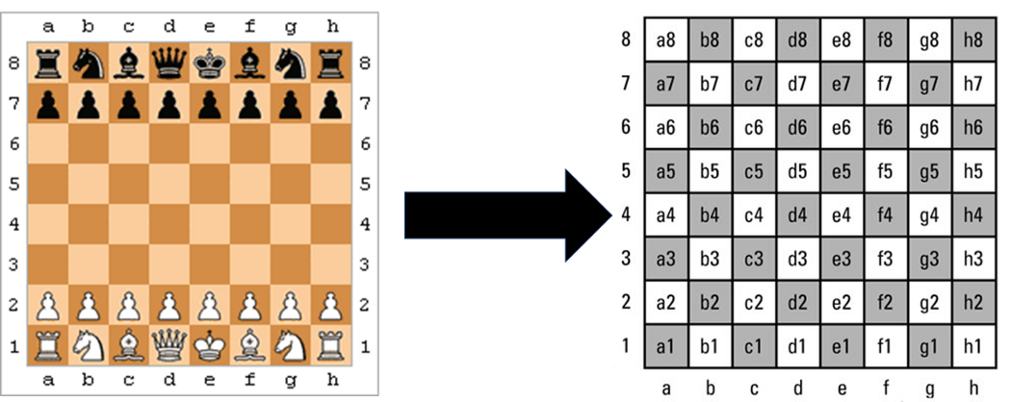
REPRESENTATION OF CHESS BOARD

Slide 13
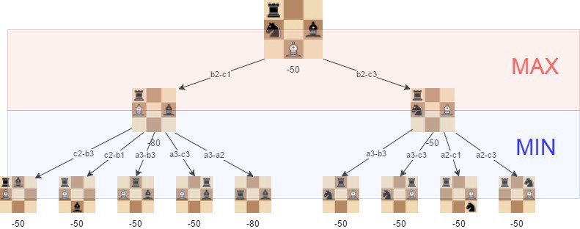
MINIMAX ALGORITHM

Slide 14
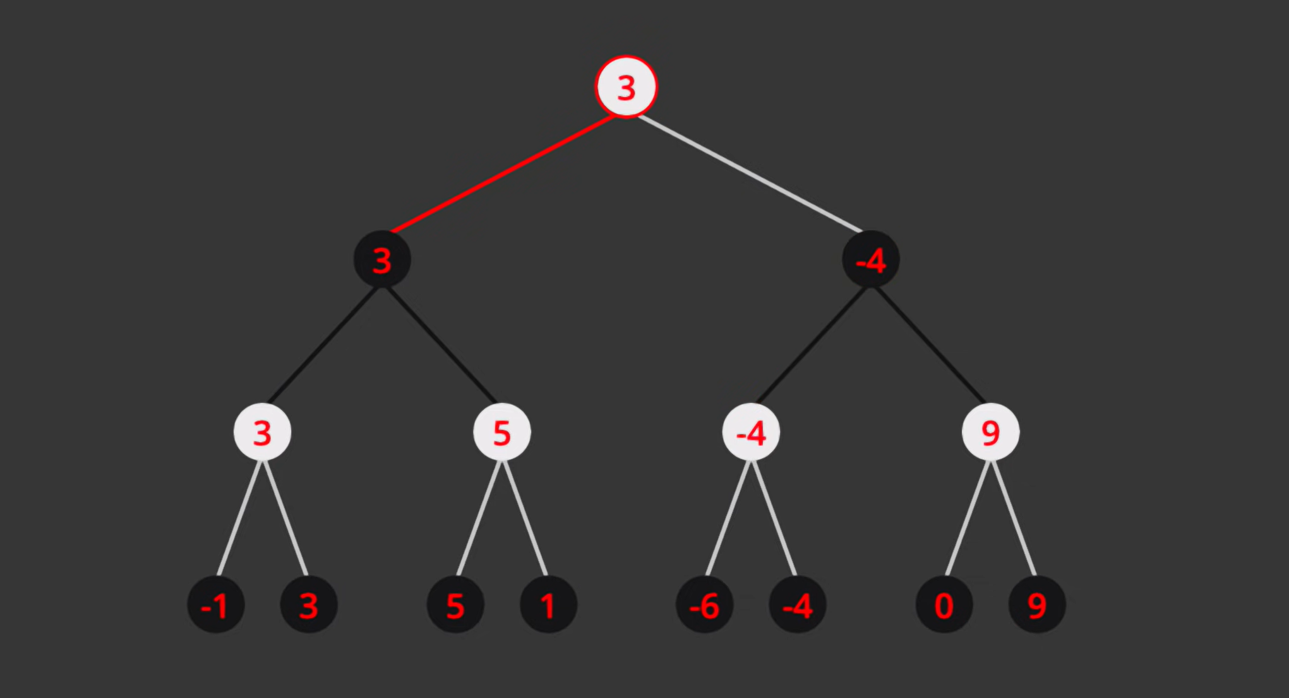
MINIMAX ALGORITHM

Slide 15
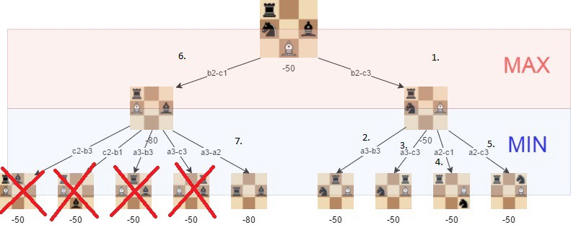
ALPHA-BETA PRUNING

Slide 16
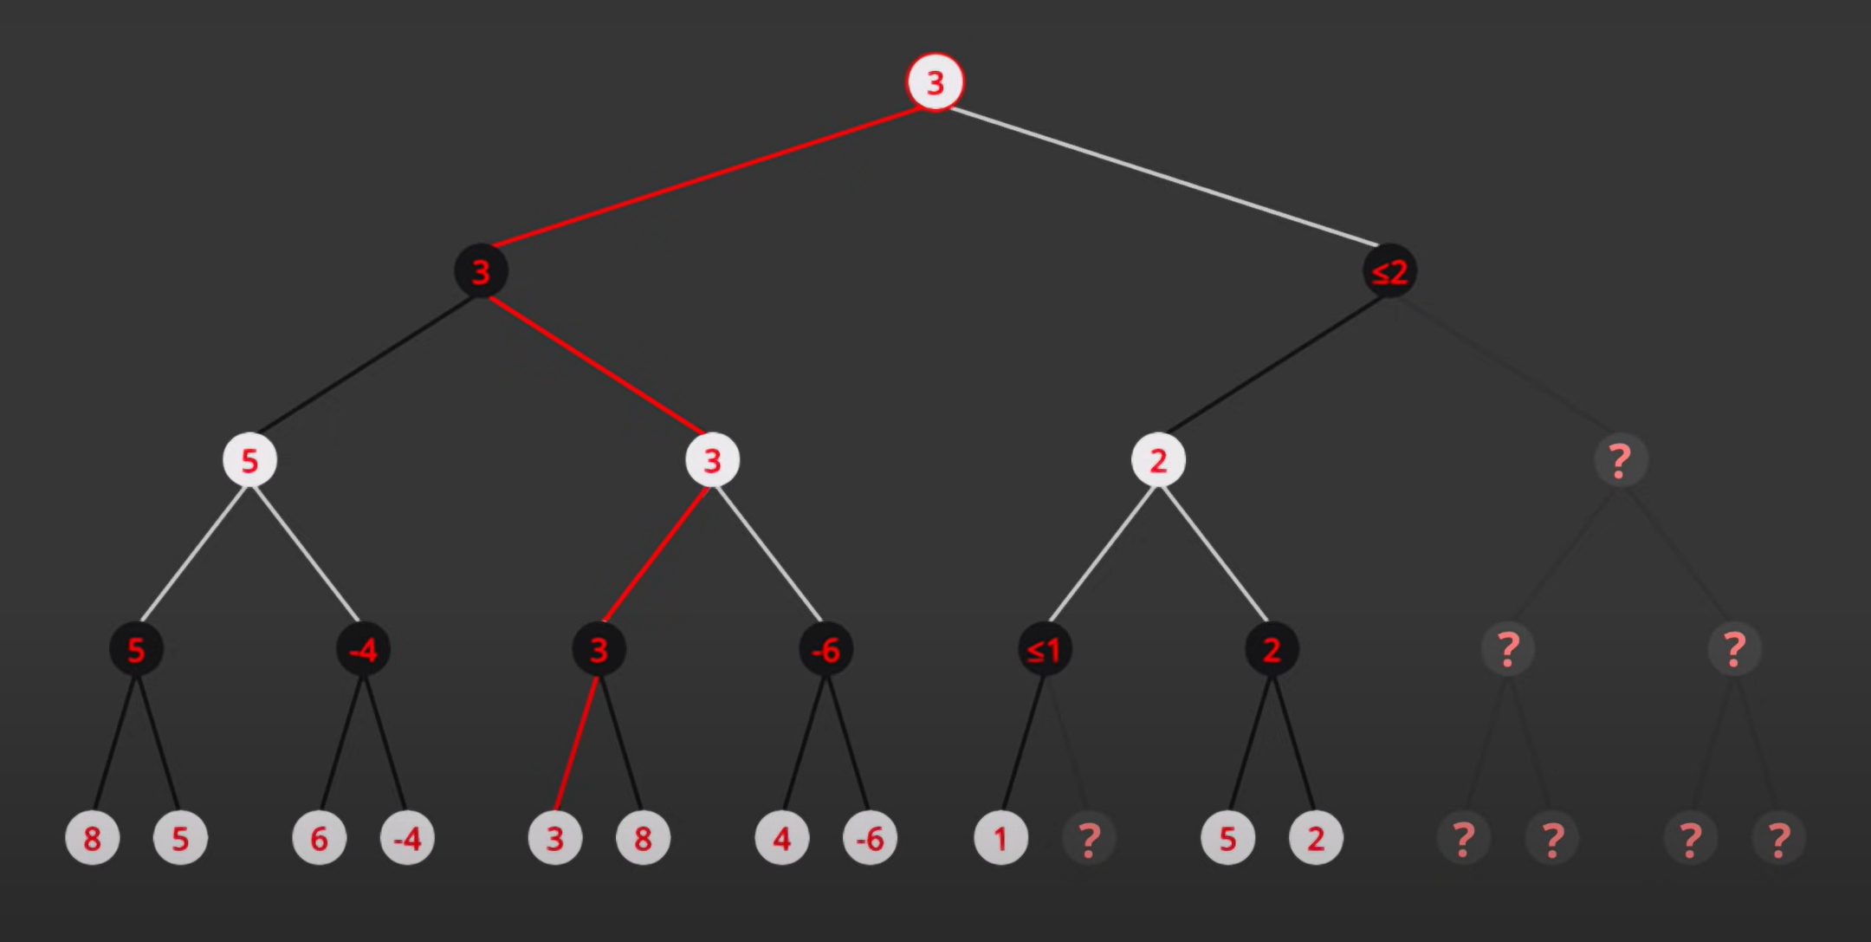
ALPHA-BETA PRUNING

Slide 17
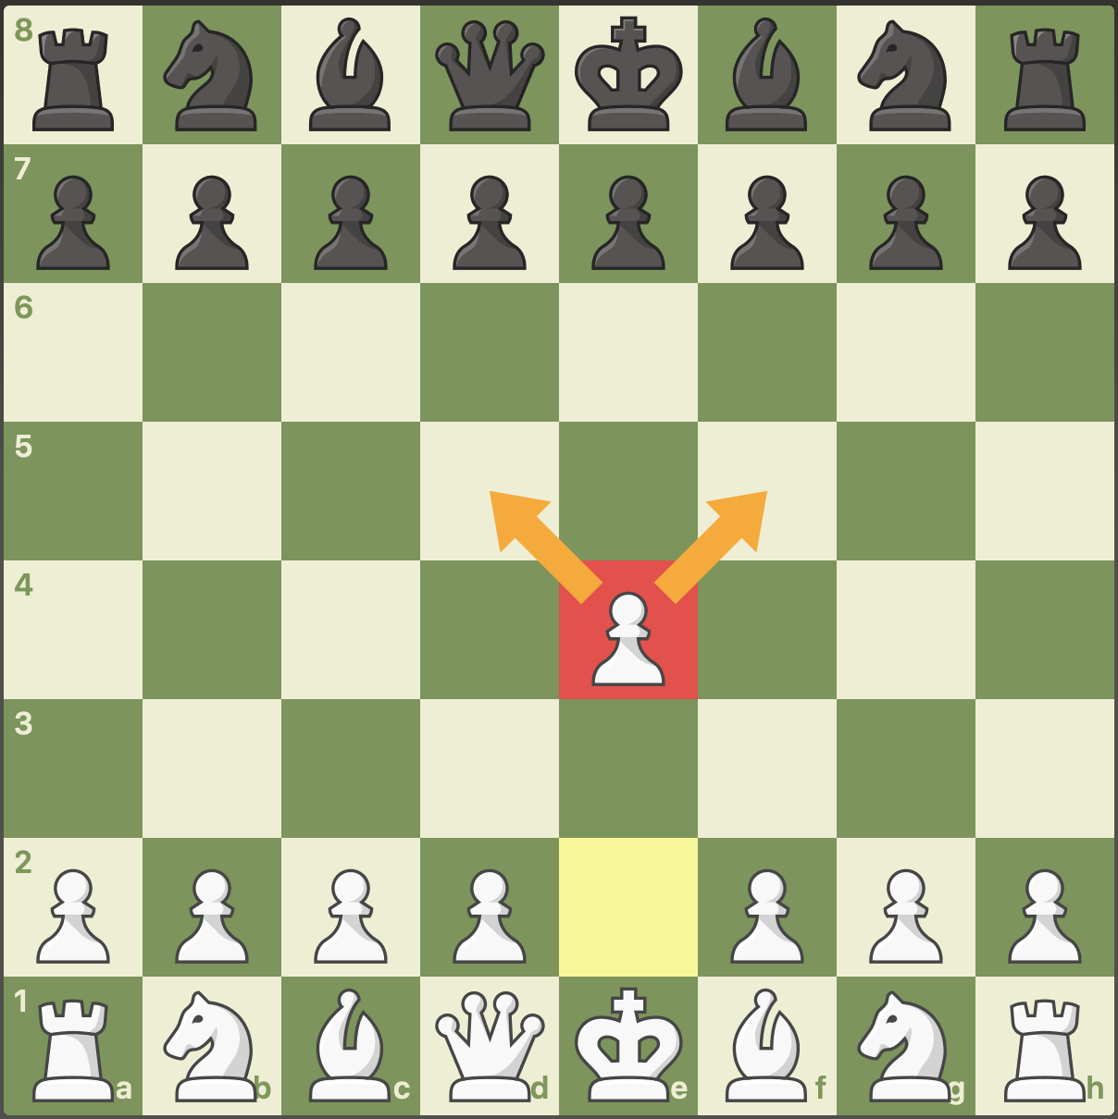
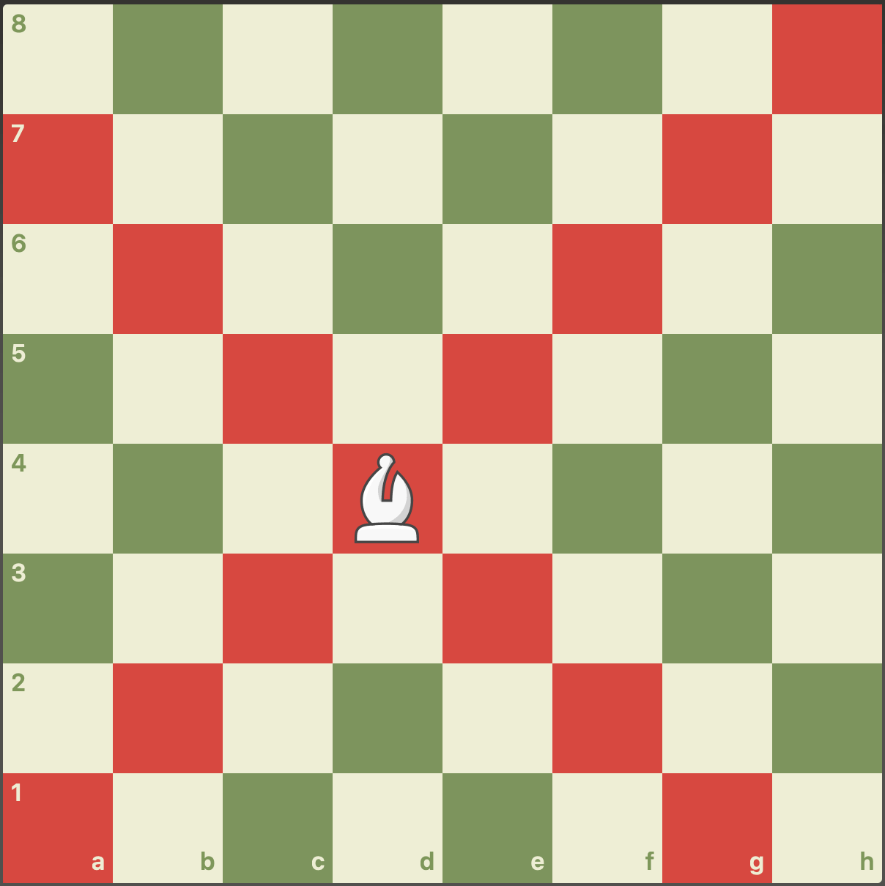
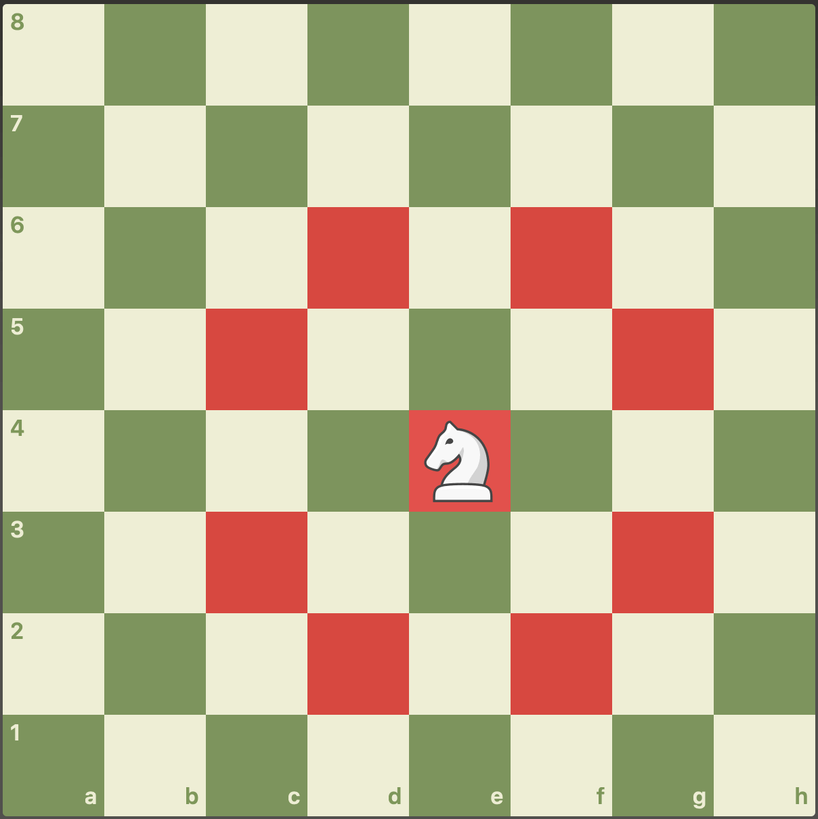
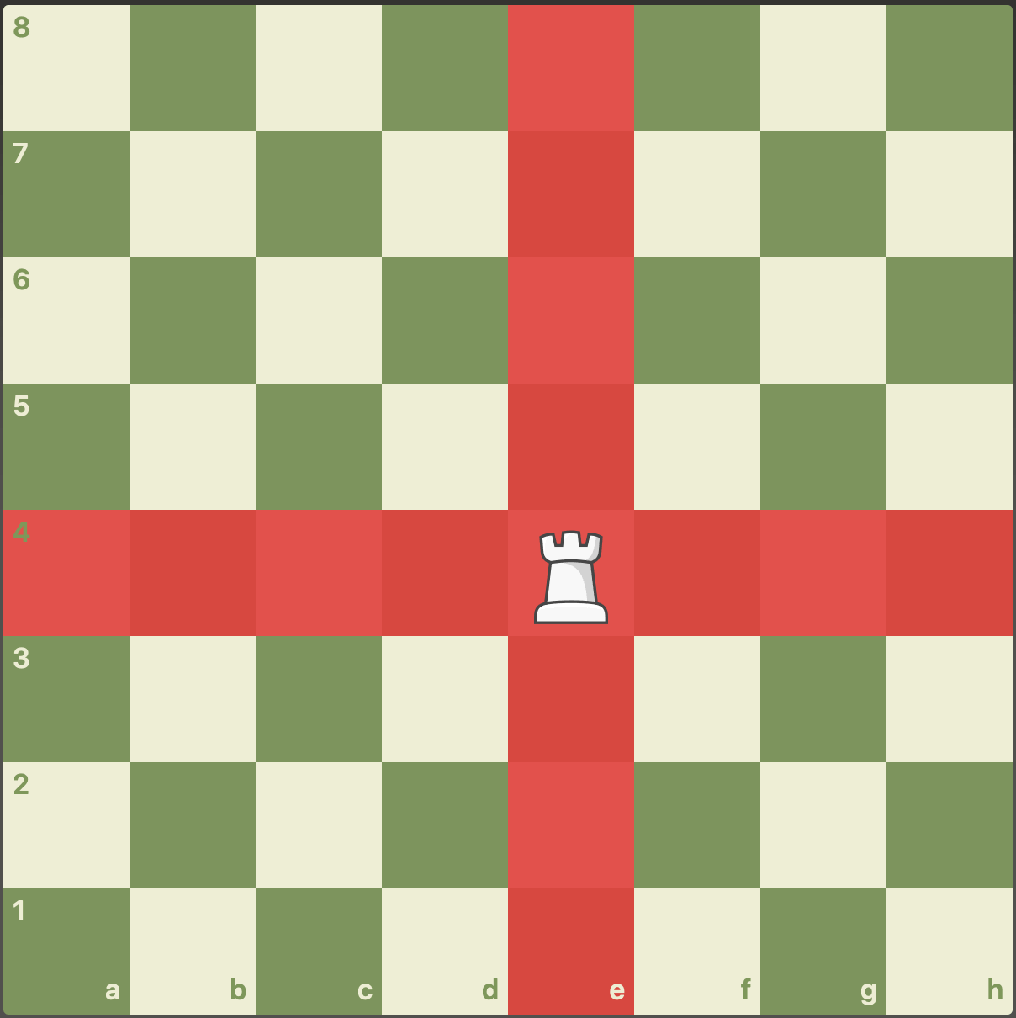
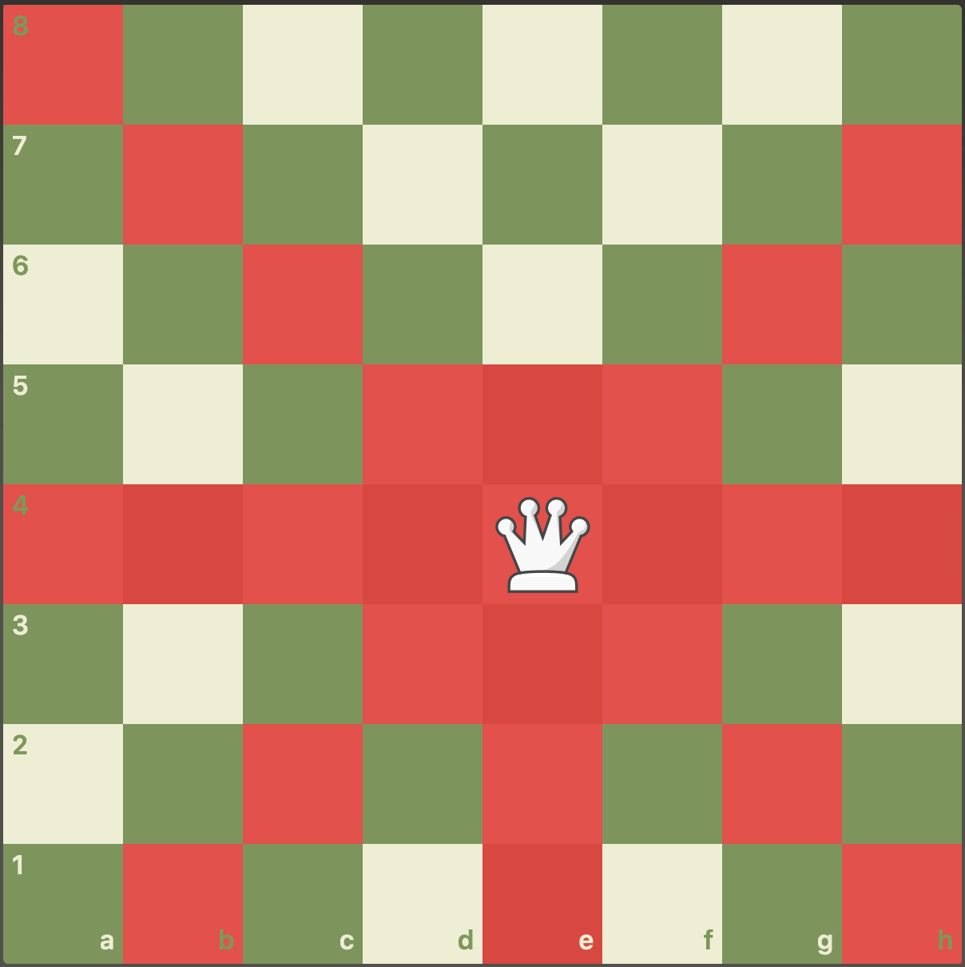
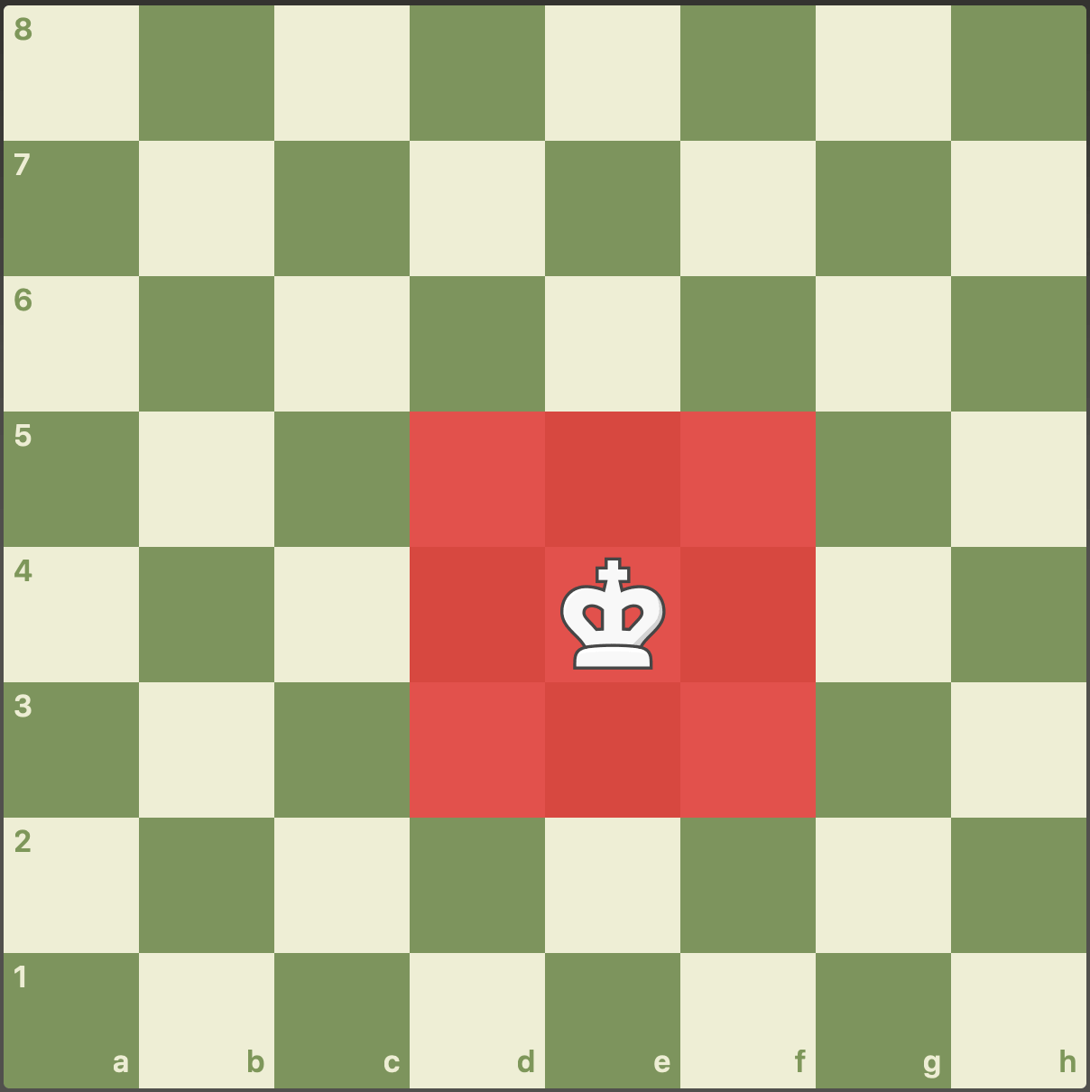
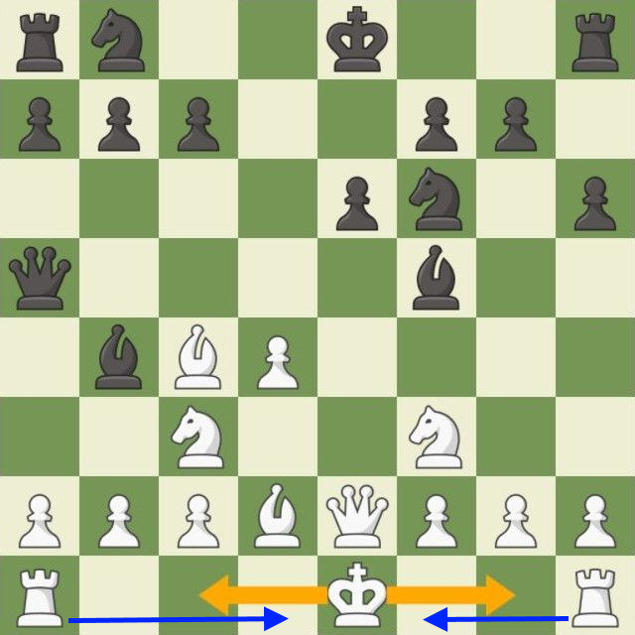
PROGRAMMING DIFFERENT MOVES FOR DIFFERENT PIECES
Fig. 2: Pawn’s movement
Fig. 3: Bishop’s movement
Fig. 4: Knight’s movement
Fig. 5: Rook’s movement
Fig. 6: Queen’s movement
Fig. 7: King’s movement
Fig. 8: Castling

Slide 18
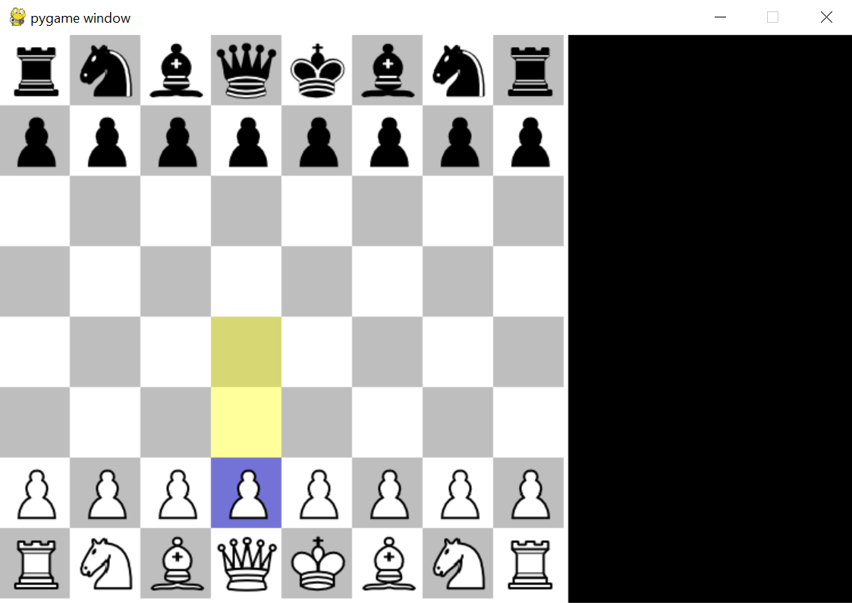
RESULT
Fig. 9: Chess board

Slide 19
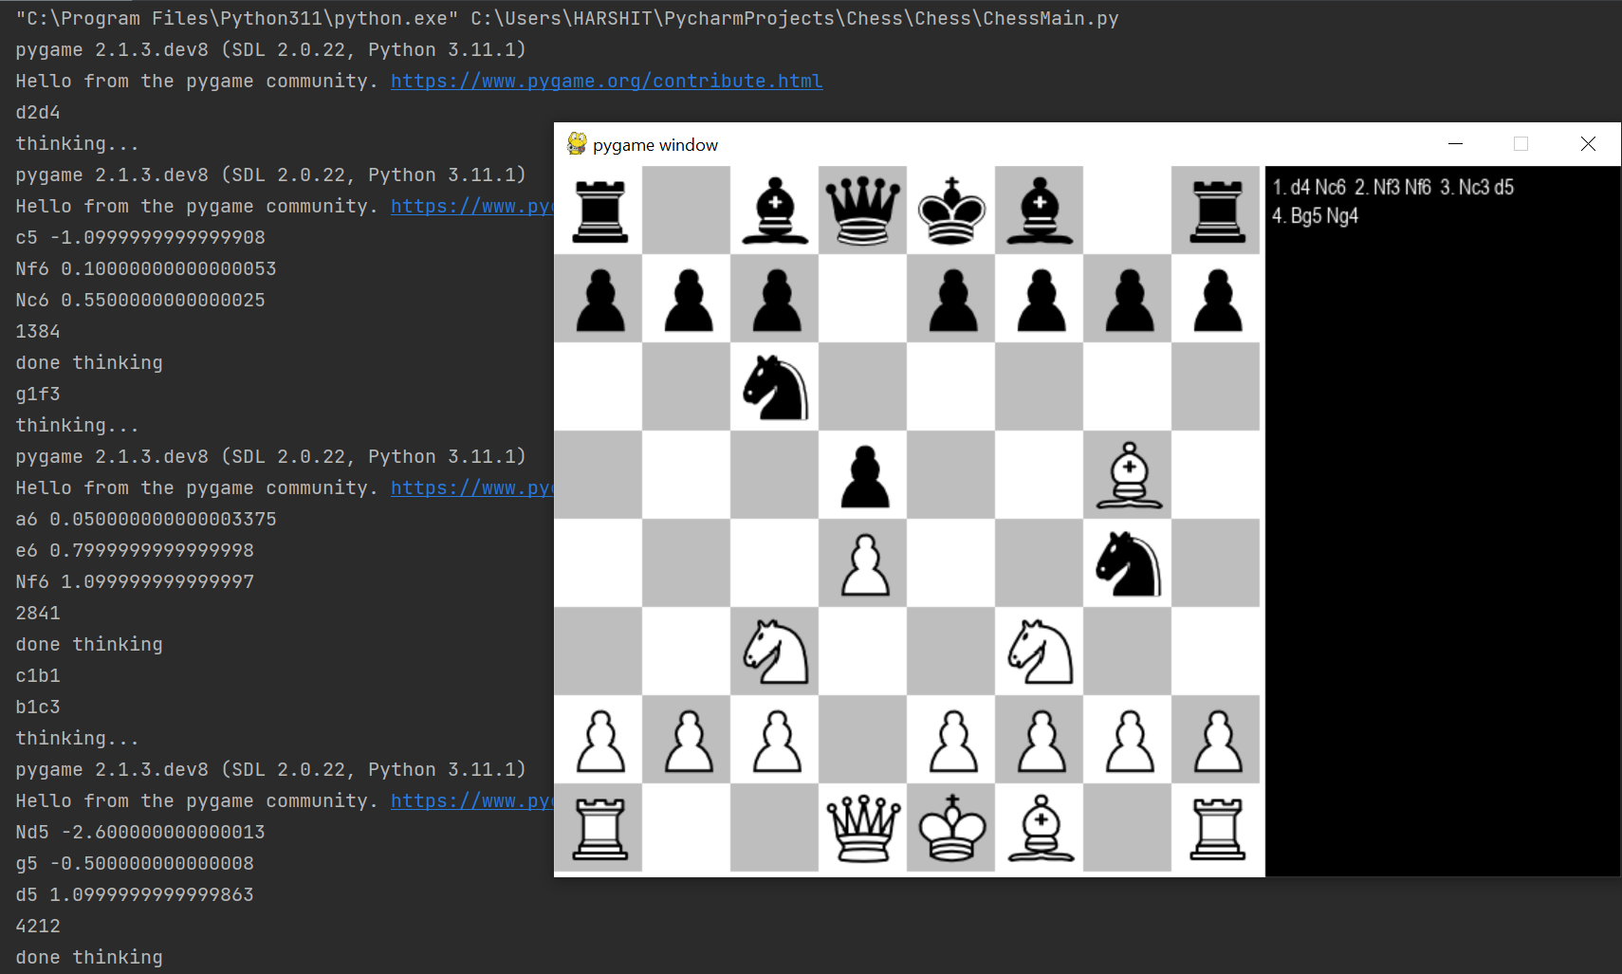
RESULT
Fig. 10: Move calculation

Slide 20
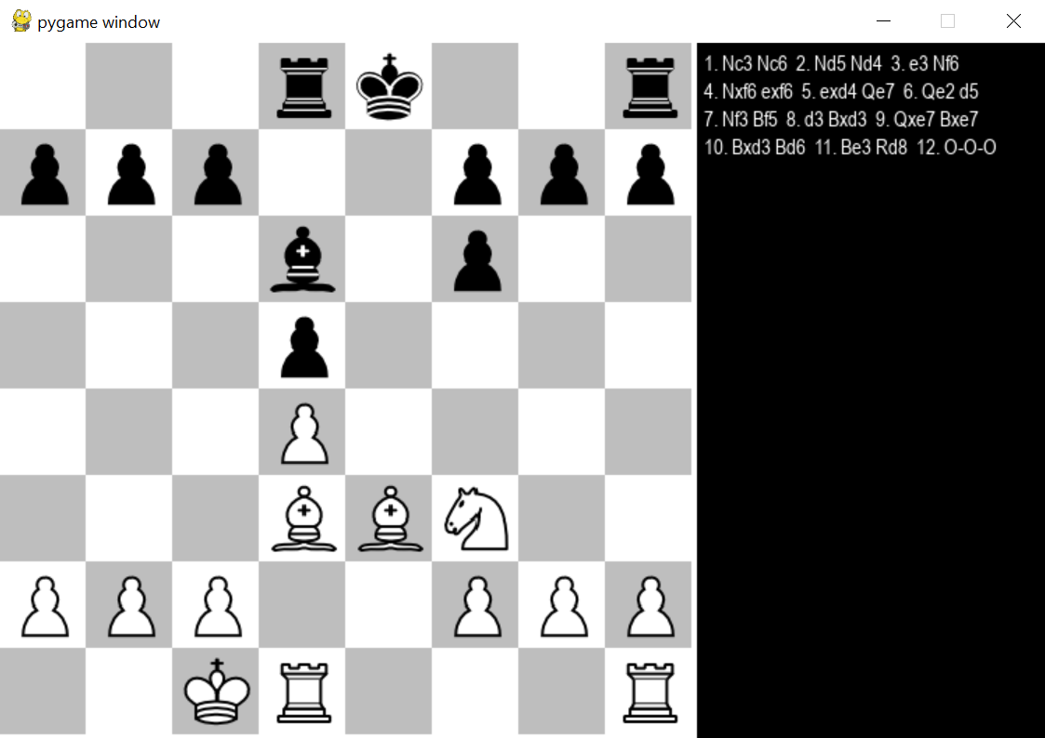
RESULT
Fig. 11: Gameplay

Slide 21
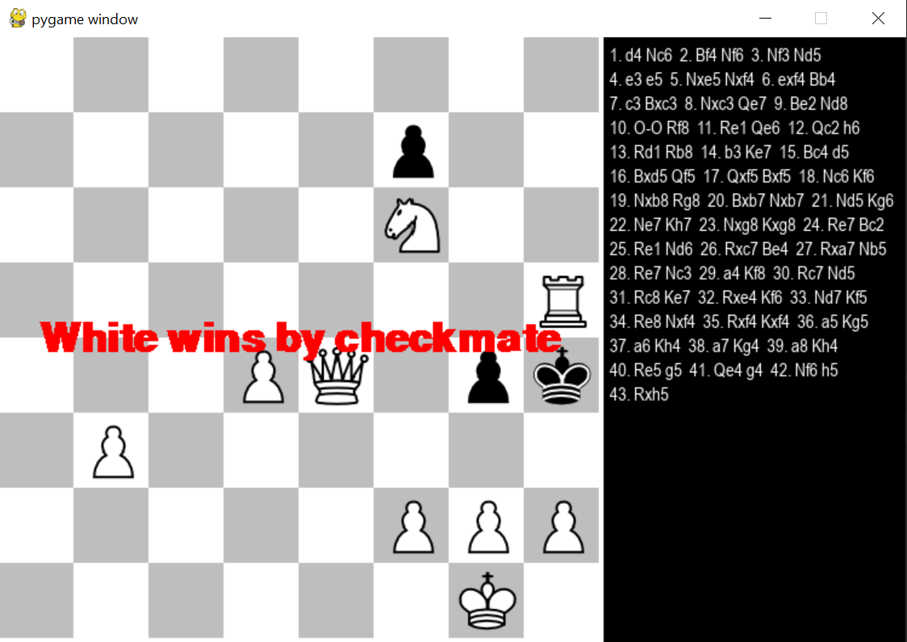
RESULT
Fig. 12: Game over

Slide 22
CONCLUSION
Successfully created a chess game with AI, by the help of various algorithms and techniques, which can be helpful for analysis, entertainment and training.

Slide 23
FUTURE WORK
Improving the AI by adding different openings, data from grandmasters gameplay and developing better algorithms.

Slide 24
REFERENCES
[1] Robert Levinson, Feng-hsiung hsu, T. Anthony Marsland, Jonathan Schaeffer and David E. Wilkins, January 1991, “Role of chess in artificial intelligence research”, Proceeding of the 12th International Joint Conference on Artificial Intelligence, 547-542.
[2] Vladimir Karapetyan, December 2021, “Functions of algorithmic thinking in the process of demonstrating chess skills”, Problems of Psychology in the 21st Century, vol.15, 48-52.
[3] Shiva Maharaj, Nick Polson and Alex Turk, April 2022, “Chess AI: Competing Paradigms for Machine Intelligence”, Entropy 24(4):550.
[4] Jimeet Viren Shah, December 2020, “Minimax algorithm”.
[5] Gaurav Parihar and Raghavendra R, April 2022, “Chess playing AI”, International Journal of Creative Research Thoughts (IJCRT), vol.10, 2320-2882.

Slide 25
THANK YOU !!

